Slide 1
Vision
Kenneth Church
September, 2025

Slide 2
Agenda: Unifying Themes: Scaling, Growth & Collaboration
Macro (Large Market Forces)
Micro (Personal Research)
Moore’s Law: Everything is getting better
but at different rates
Peak Data:
Scaling laws assume unlimited data
Language data: limited by population bound
Who can afford to play?
Narrative: Big companies with deep pockets
DeepSeek showed anyone can contribute
Clouds → Phones
Inference >> Training
“Diseconomies of scale”
Implications for global warming
Unify LLMs and Linear Algebra
SVD with Batching
Better Together
Academic Search
BERT Embeddings of Papers
Spectral Clustering of Citations
Loss Functions
Entropy: Predict the next word
Nuclear Norm: within → across
Low Resource Languages →
Growth Opportunities
Target languages with future demand
Many speakers and impressive GDP growth

Slide 3
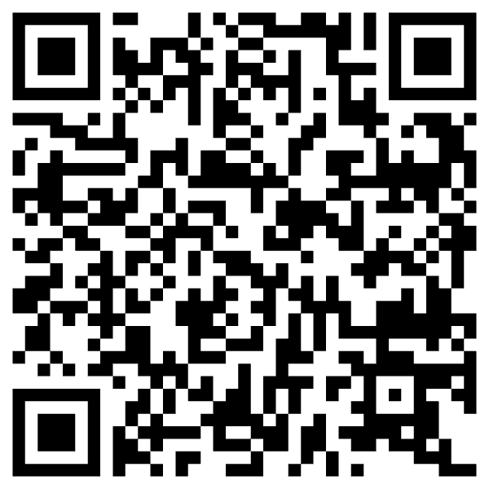
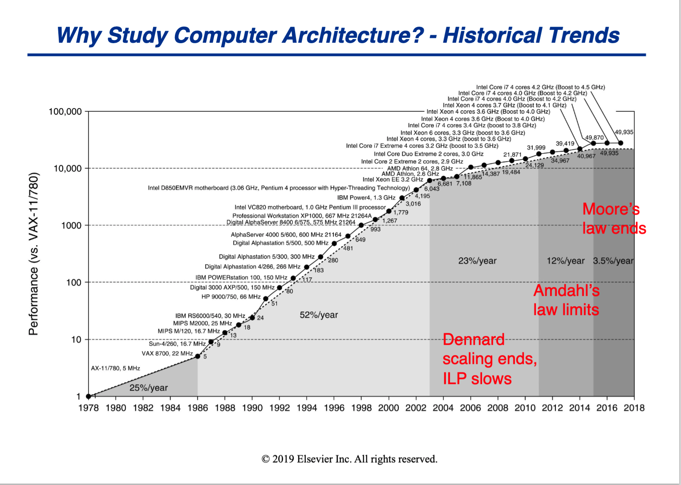
Everything is getting better SPEC Benchmark: 50k speedup over 40 years
https://courses.grainger.illinois.edu/CS433/fa2021/slides/chapter1-part1-post-lecture.pdf

Slide 4
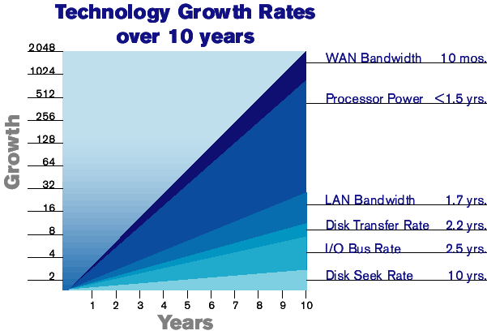
Exponential Improvements Everywhere, But with Different Time Constants
R&D Budget
Physics

Slide 5
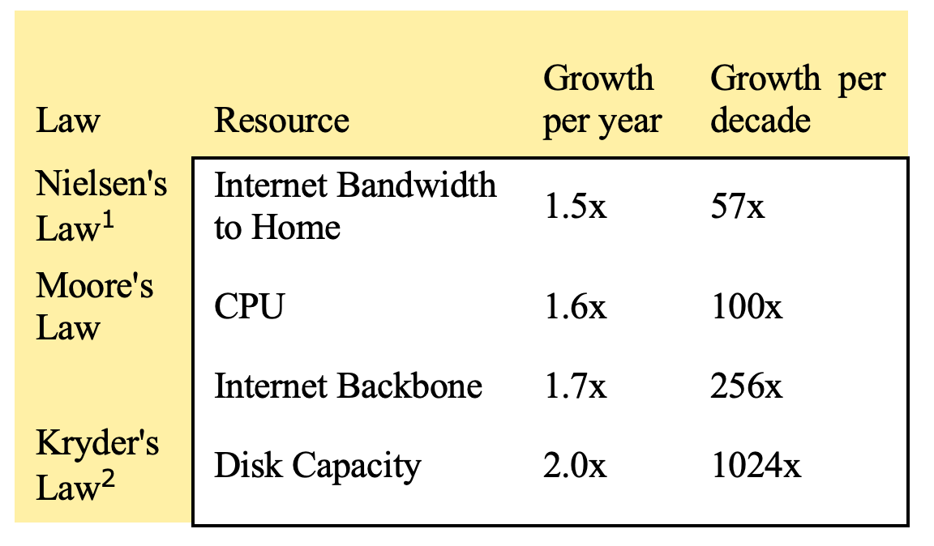
Mobility Gap: Disks >> Bandwidth

Slide 6
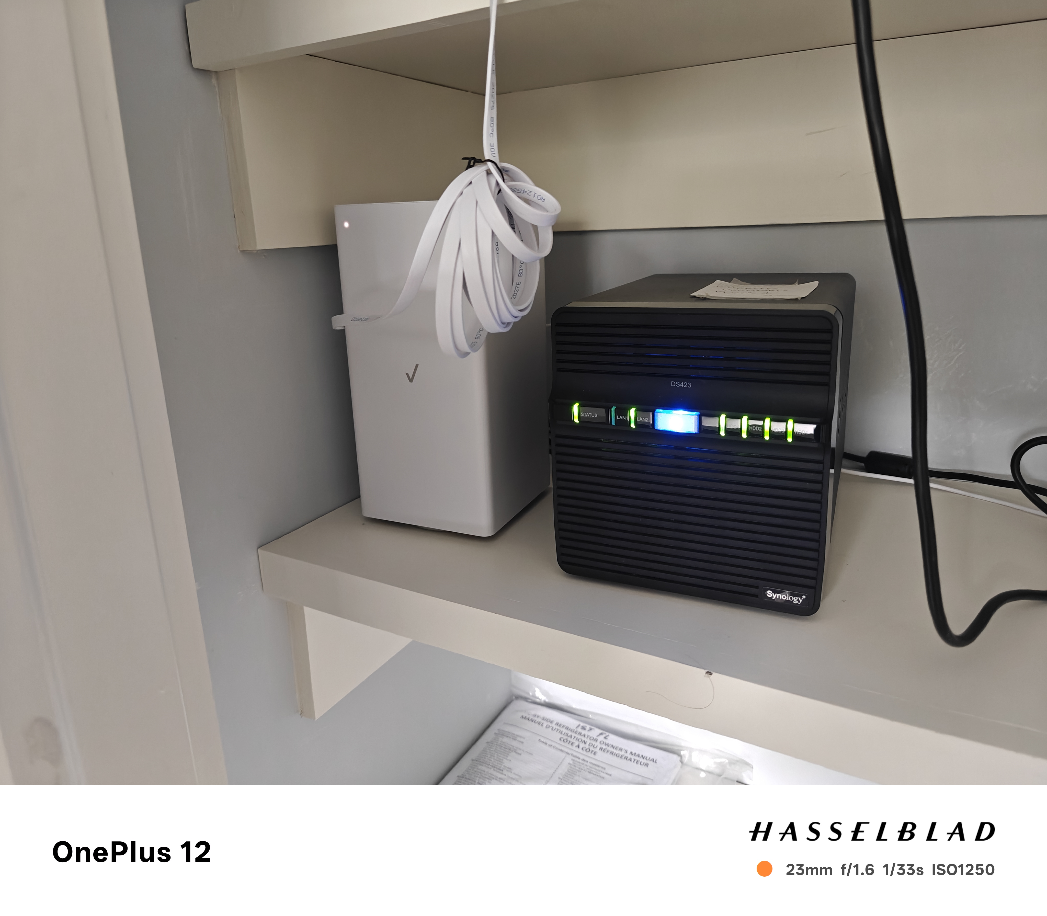
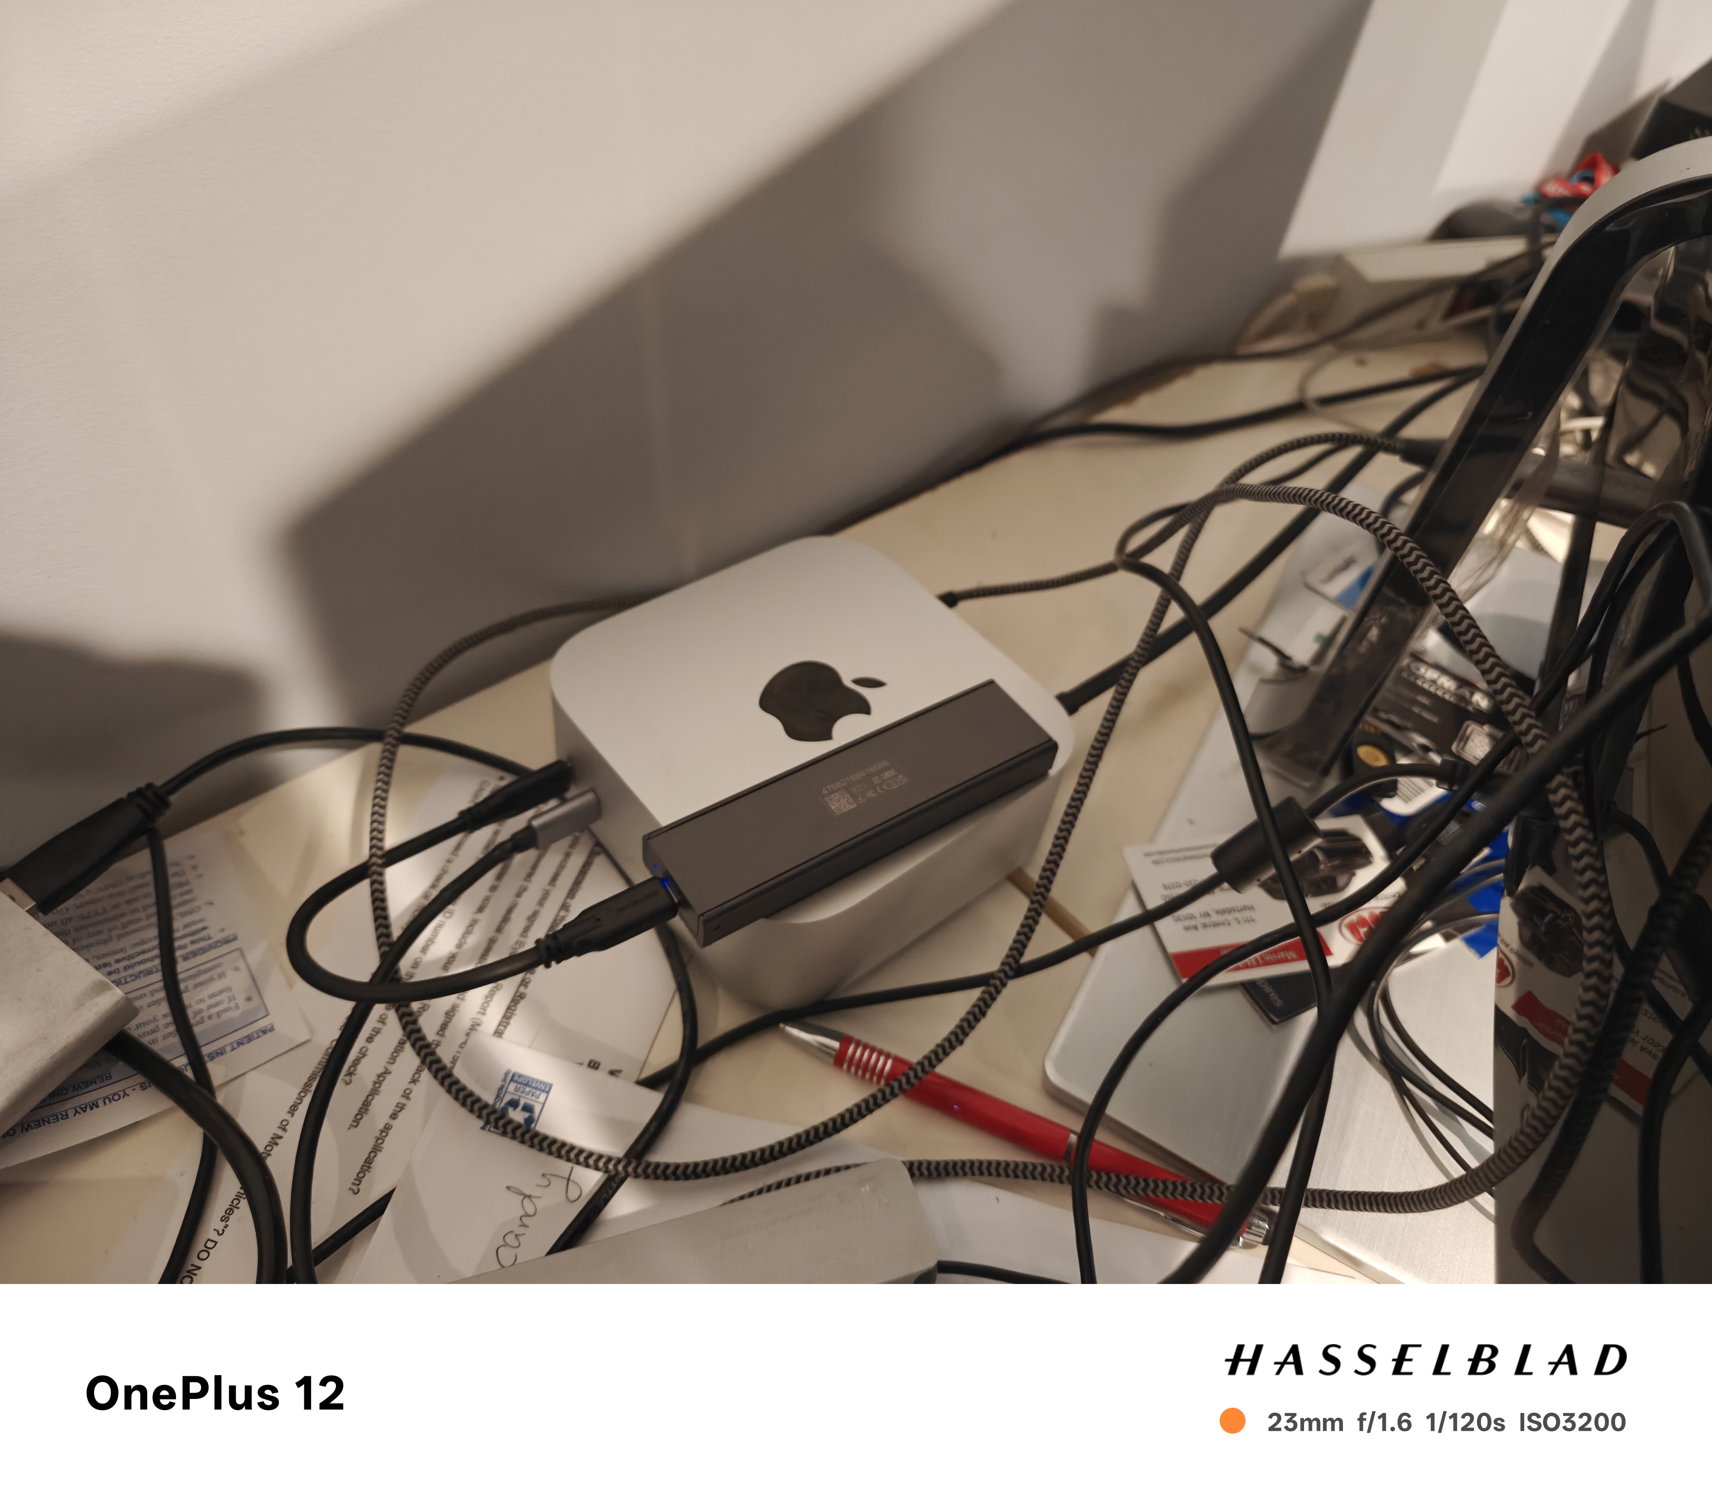
Clouds → Edge (Phones, NAS, etc.) AWS: $276/TB/year
Disk: 68 TBs @ $11/TB
Broadband: 2Gps @ $100/month
SSD: 4TBs @ $60/TB

Slide 7

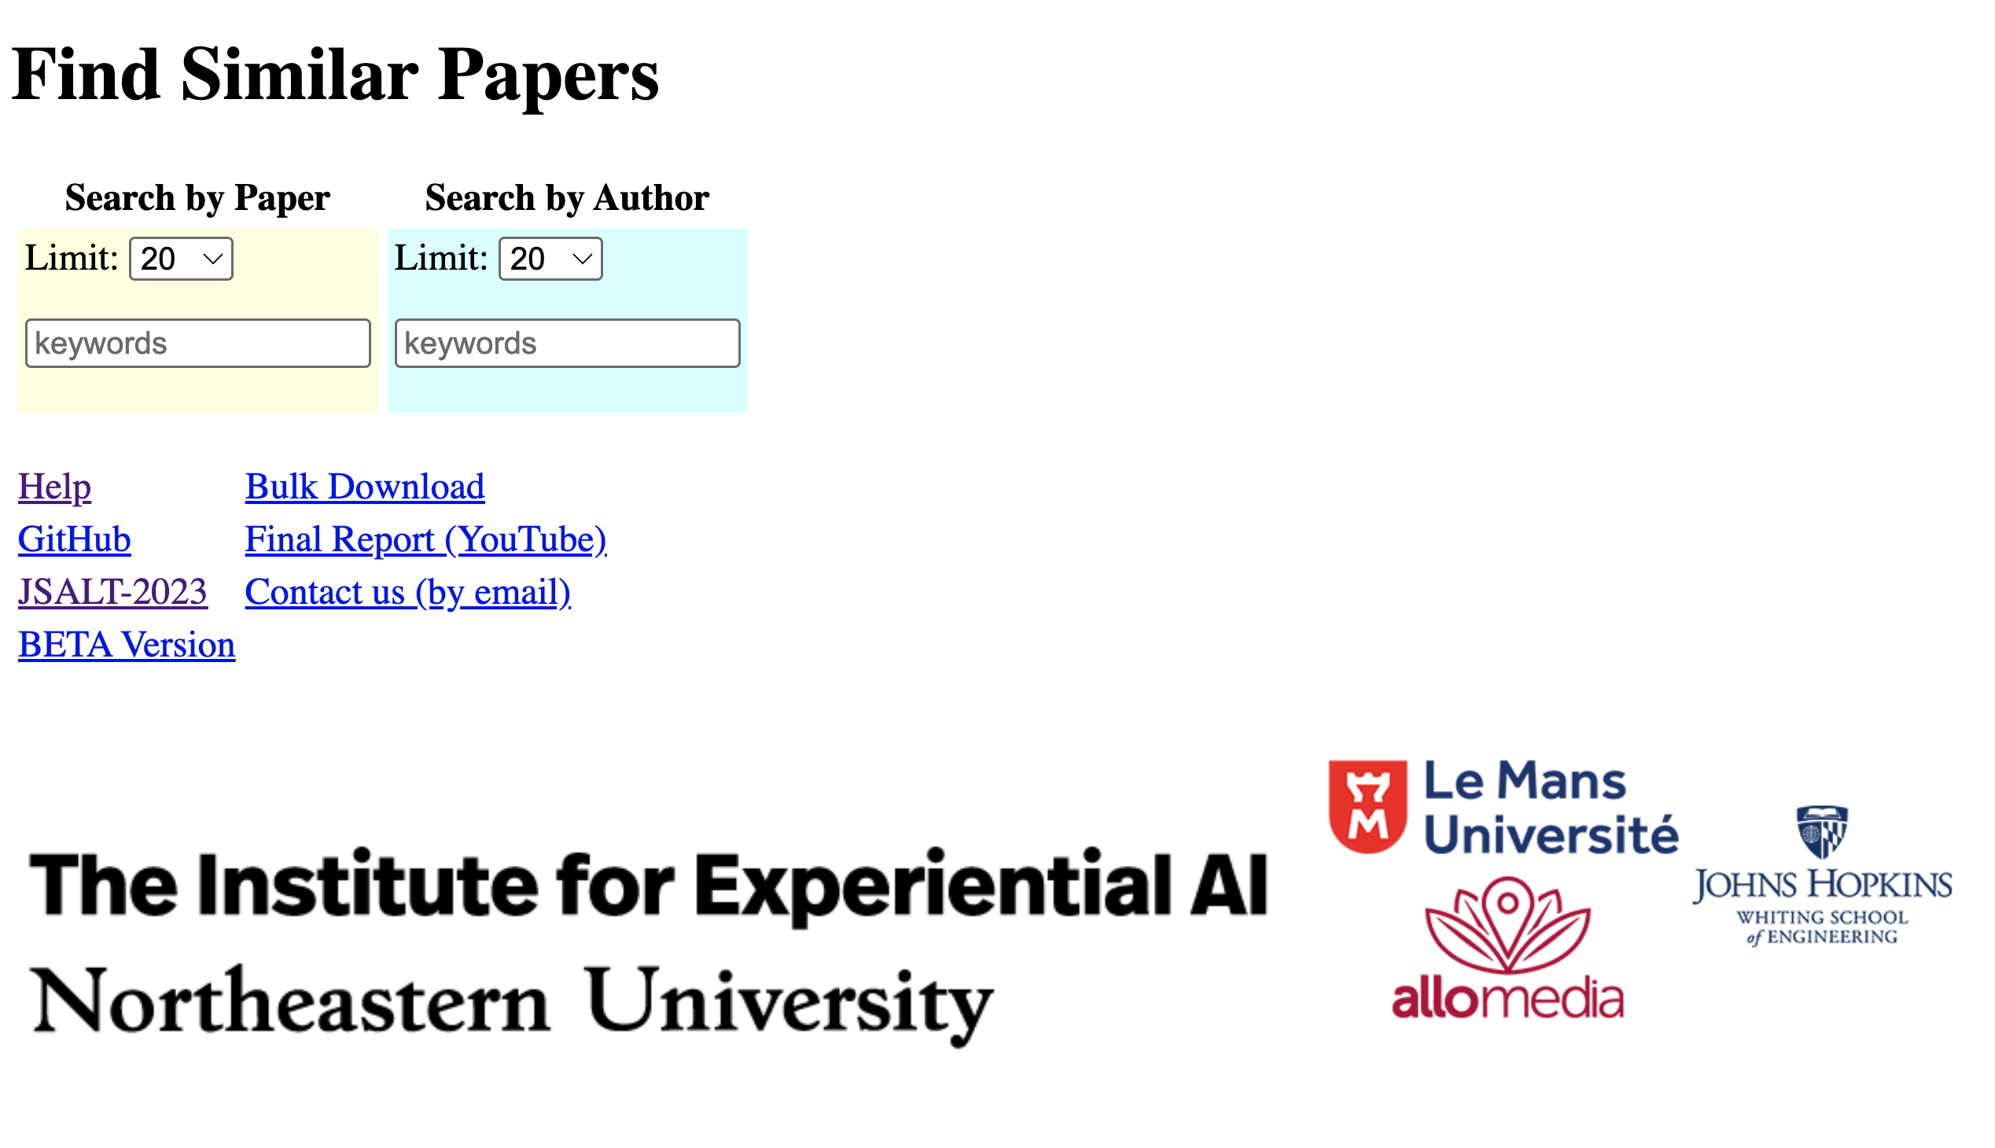
http://recommendpapers.xyz

Slide 8
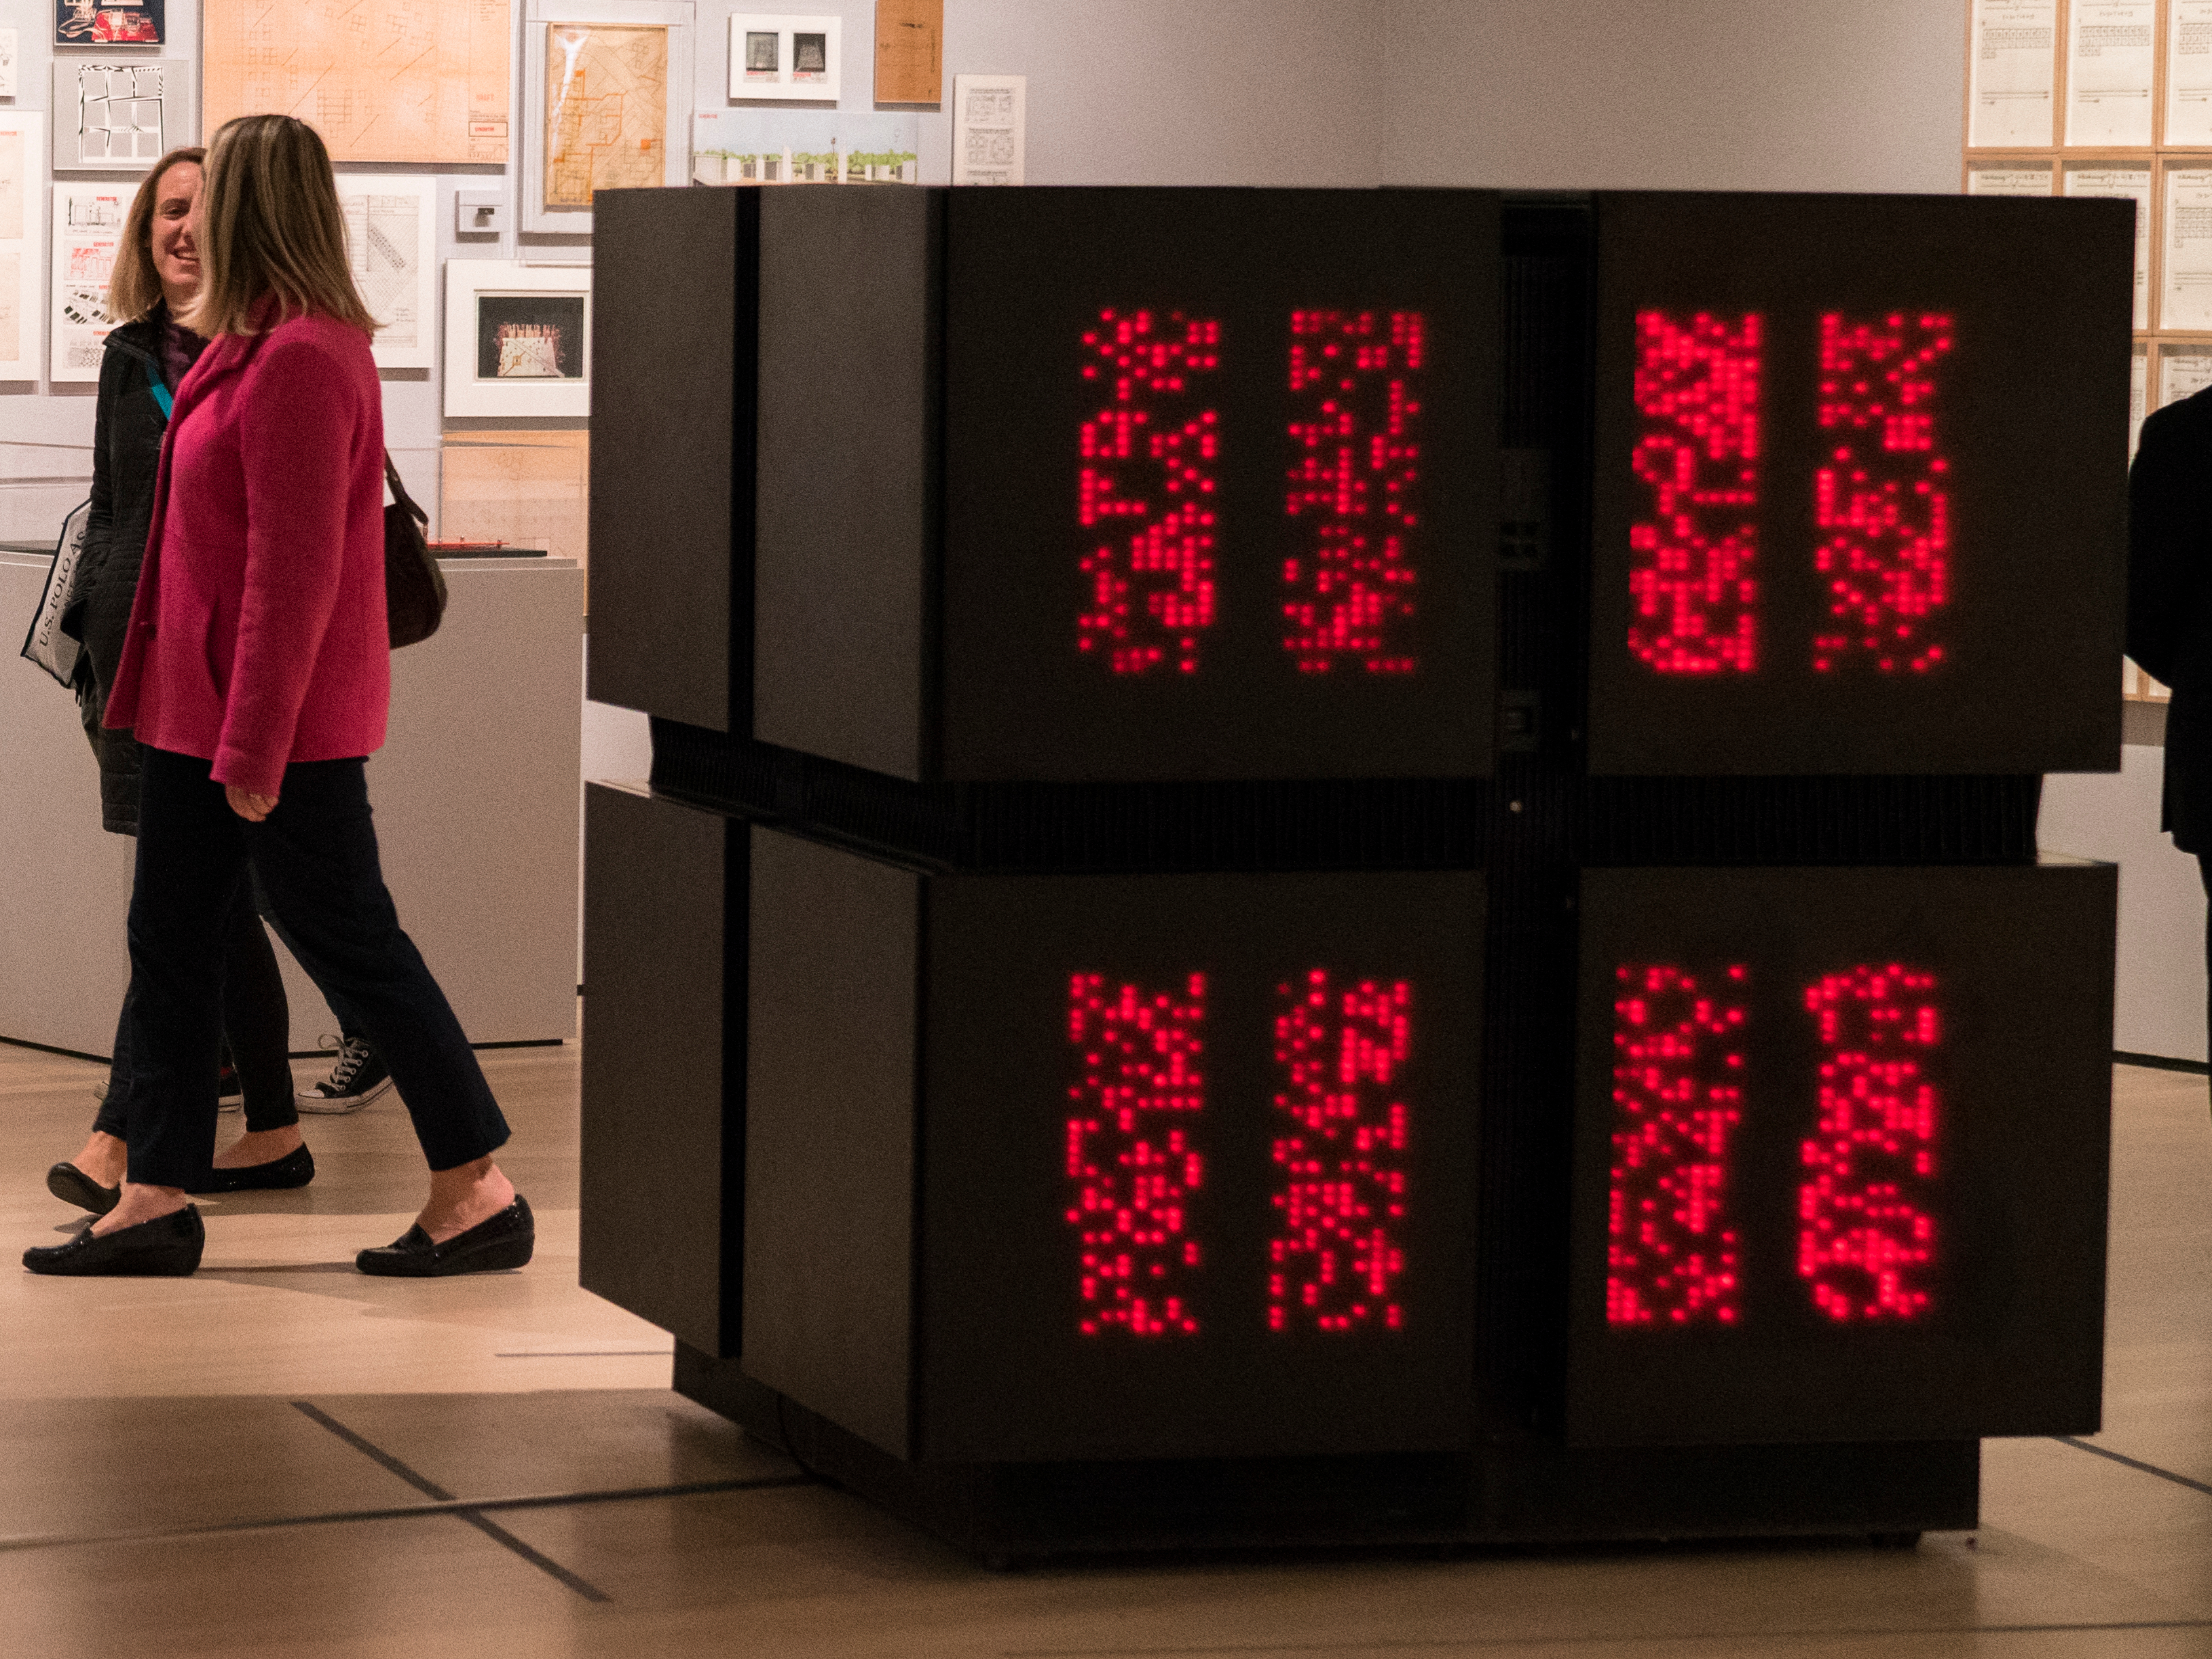
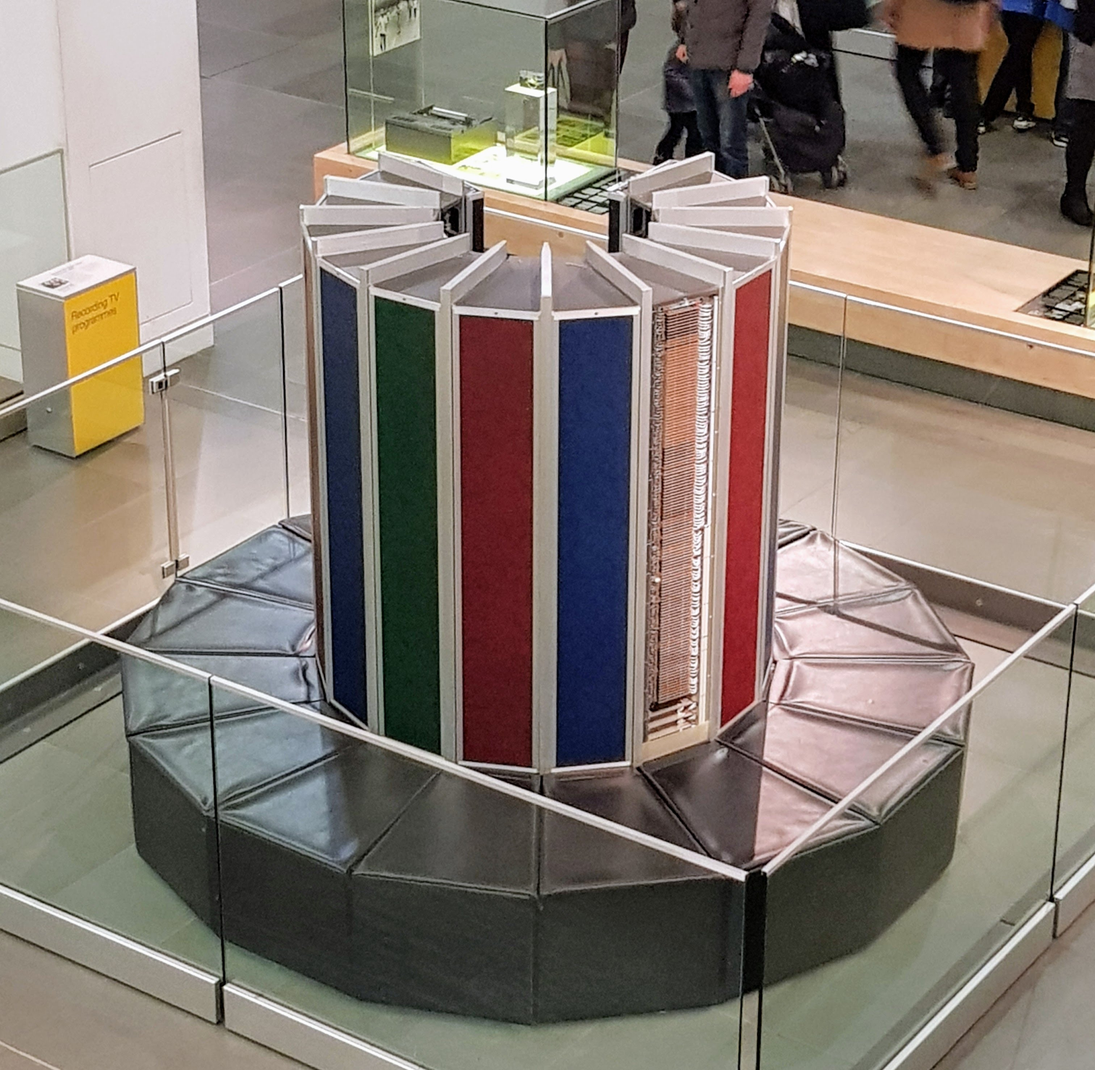
“Diseconomies of Scale” Scale depends on size of market, not machine Phones/PCs are bigger than Super-computers
Thinking Machines (CM-2)
Cray-1

Slide 9
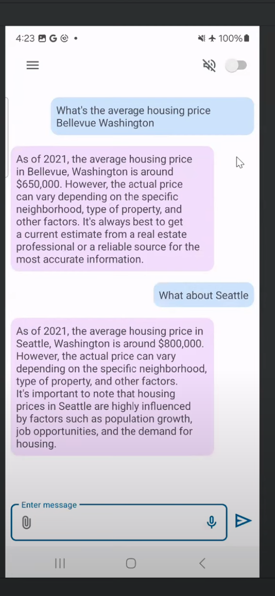

Chat on a phone What’s on the phone, stays on the phone
Phones >> Datacenters
Short-term cost
Long-term cost (Economies of scale)
Latency
Privacy
Power

Slide 10
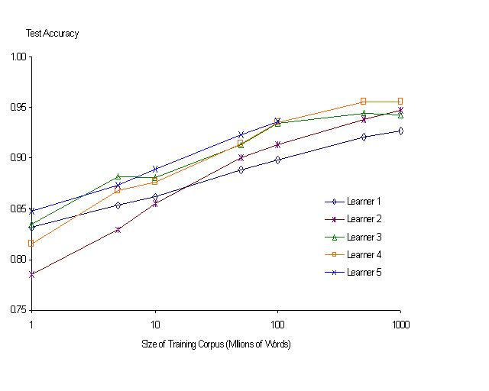
“It never pays to think until you’ve run out of data” – Eric Brill
Moore’s Law Constant:
Data Collection Rates → Improvement Rates
Banko & Brill: Mitigating the Paucity-of-Data Problem (HLT 2001)
No consistently
best learner
There is no data like more data
Quoted out of context
Fire everybody and
spend the money on data

Slide 11
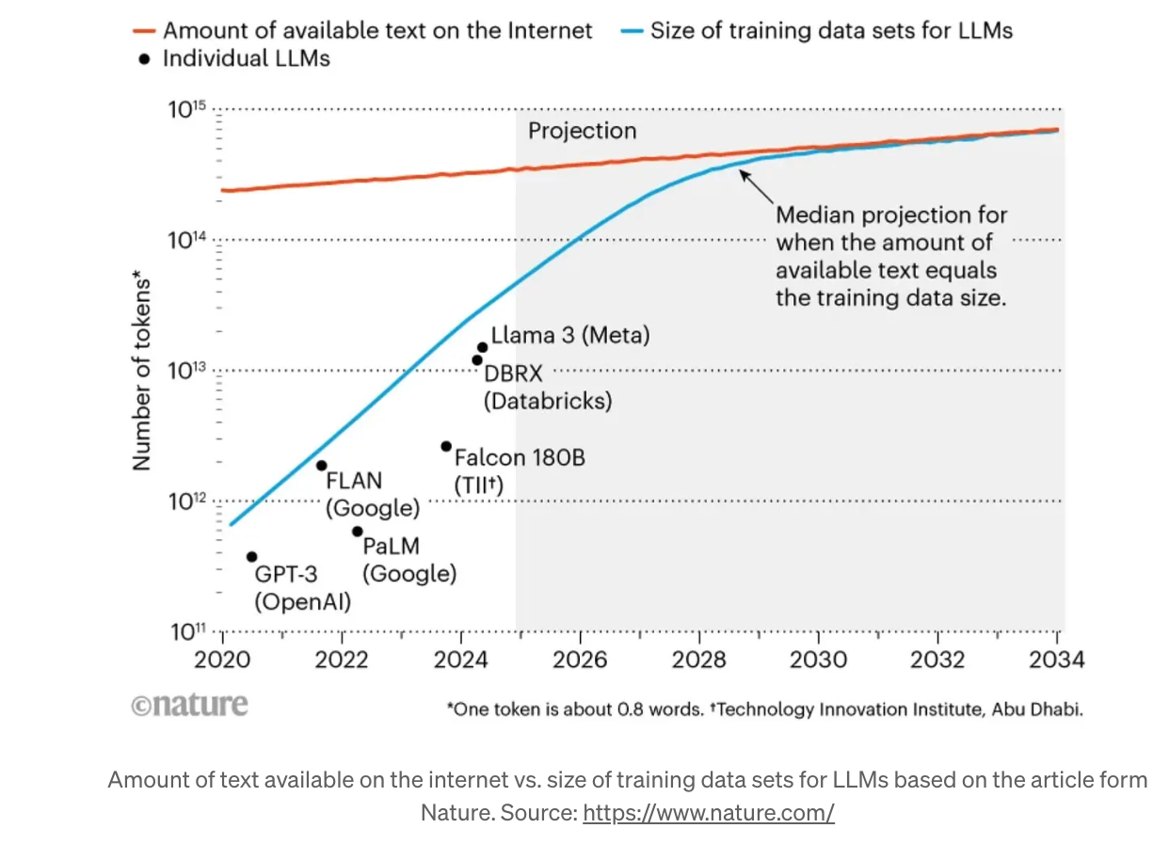
Peak Data: We are running out of data

Slide 12
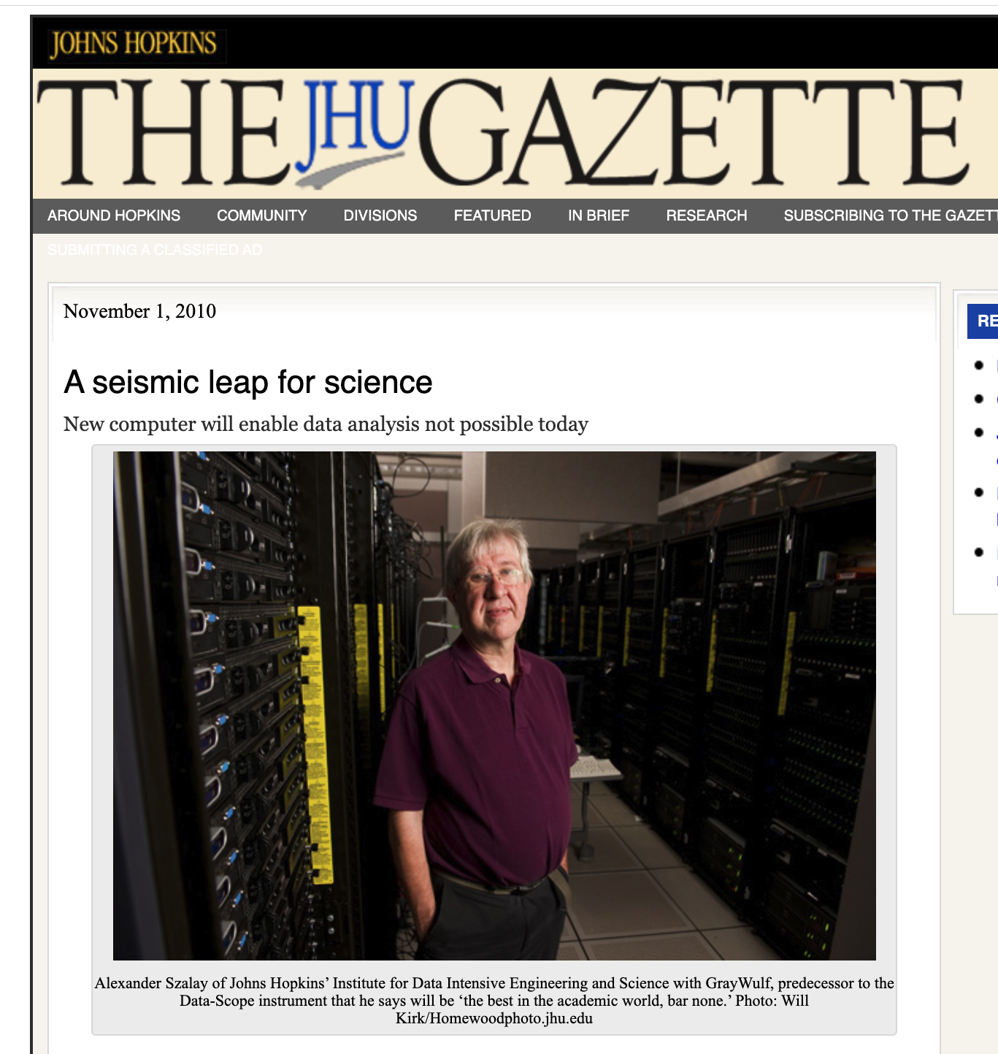
Data Scope
Collaboration with
Alex Szalay (Astronomy)
I was hoping his data would be astronomical
But data in astronomy
are limited by budgets
He was hoping speech data would be larger
but there is a population bound
Doctors at Hopkins suggested we look at DNA
Disks → 1k bigger per decade
DNA → 10k bigger per decade

Slide 13
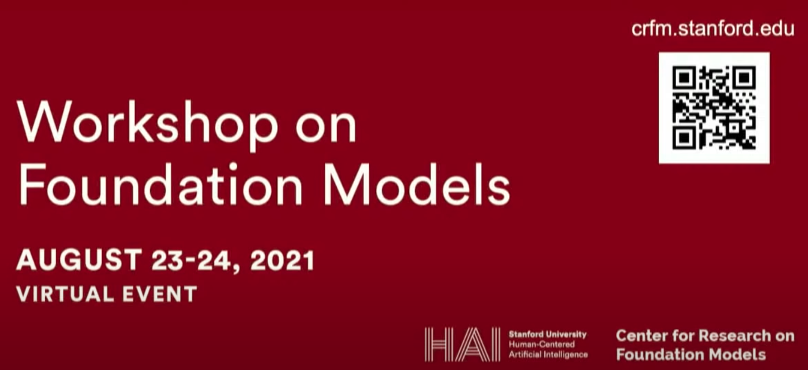
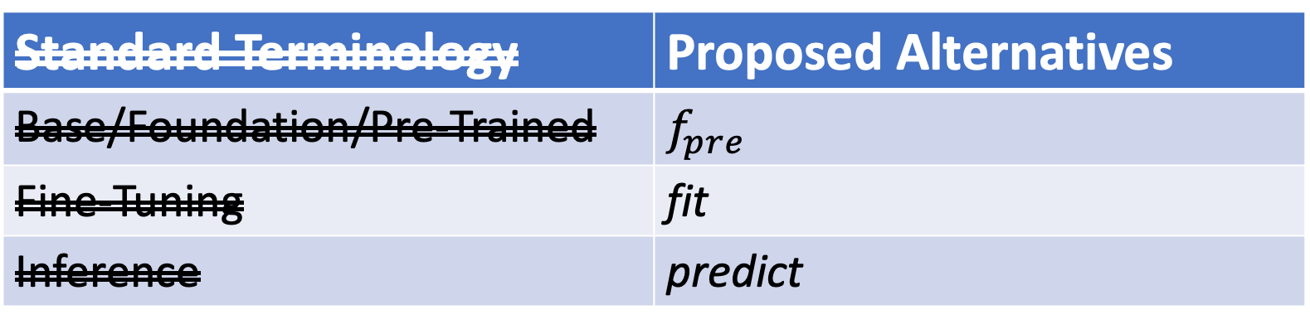
Why Change Terminology?
More opportunity for academics
Standard Terminology | Proposed Alternatives
Base/Foundation/Pre-Trained | $$f_{pre}$$
Fine-Tuning | fit
Inference | predict
Not this
Emphasize this
Emphasize this
https://www.youtube.com/watch?v=dG628PEN1fY
Industry has an unfair advantage over academia
Pre-training requires $$$$, Big Data & Logistics:
Big Investments → Risk Adverse → Less Creativity

Slide 14
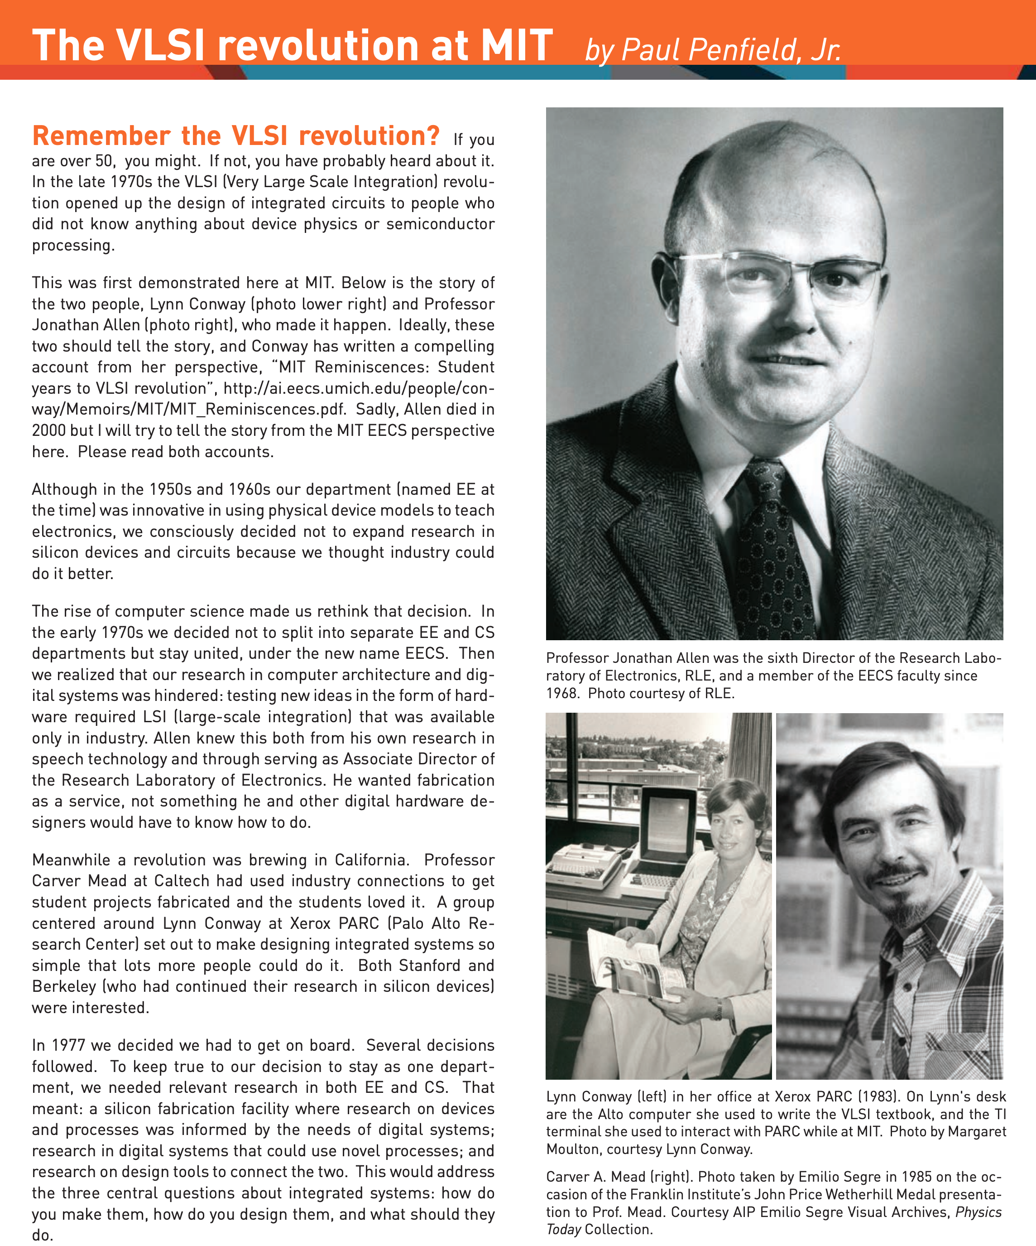
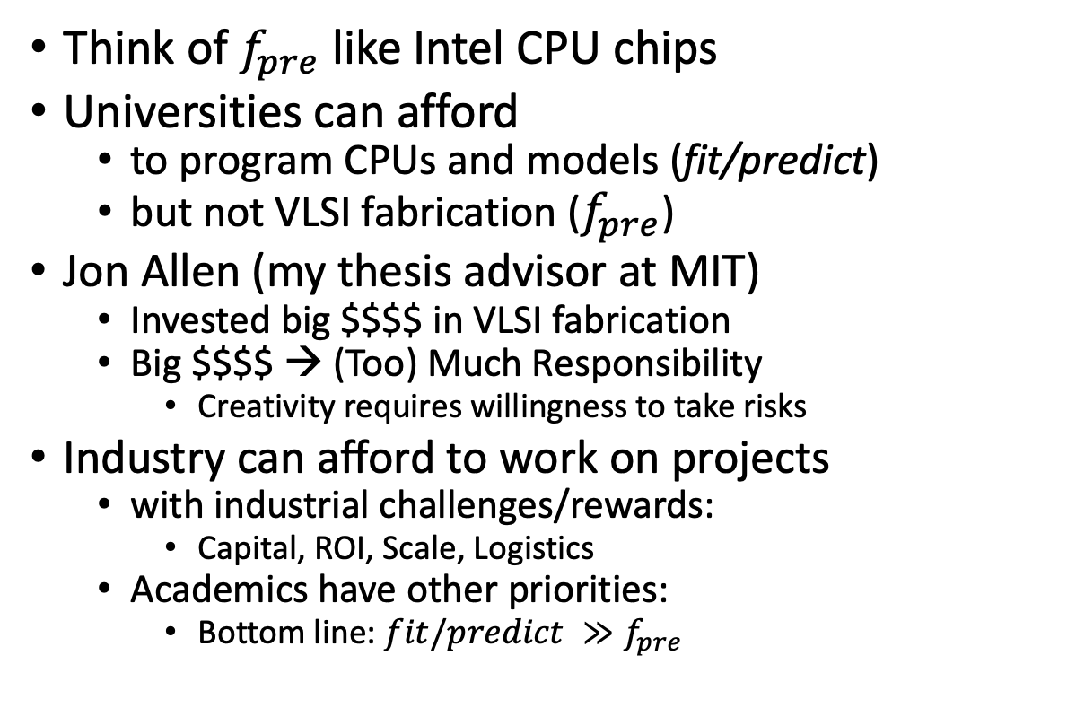
VLSI History http://www.eecs.mit.edu/docs/newsletter/VLSI.pdf http://ai.eecs.umich.edu/people/conway/Memoirs/MIT/MIT_Reminiscences.pdf
Perspective from MIT and beyond:
IBM, Silicon Valley, Mich, LGBTQ, etc.
Think of $f_{pre}$ like Intel CPU chips
Universities can afford
to program CPUs and models (fit/predict)
but not VLSI fabrication ($f_{pre}$)
Jon Allen (my thesis advisor at MIT)
Invested big $$$$ in VLSI fabrication
Big $$$$ → (Too) Much Responsibility
Creativity requires willingness to take risks
Industry can afford to work on projects
with industrial challenges/rewards:
Capital, ROI, Scale, Logistics
Academics have other priorities:
Bottom line: $fit/predict ≫f_{pre}$

Slide 15
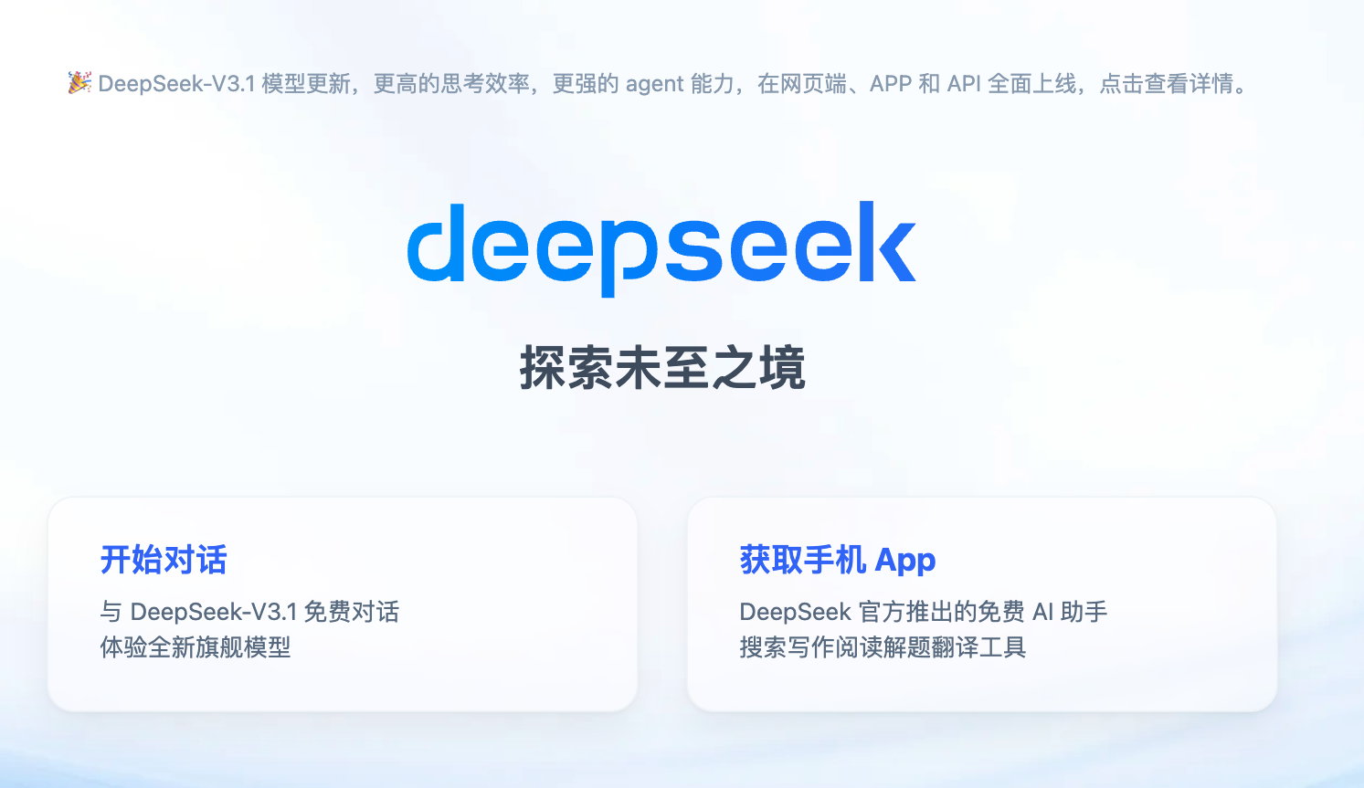
Anyone (even academics) can afford to play!

Slide 16
Bottlenecks
People
Data (Empiricism)
Bandwidth
Storage
CPUs
GPUs
Everything is getting better
But at different rates
In addition,
supply is increasing
faster than demand
Historically,
If we build it, they will come
But if everyone has more compute than they need
will they continue to come
Challenge:
find new killer apps
(so demand keeps up with supply)

Slide 17
My Current Research
Unify LLMs and Linear Algebra
SVD with Batching
Better Together
Academic Search
BERT Embeddings of Papers
Spectral Clustering of Citations
Loss Functions
Entropy: Predict the next word
Nuclear Norm: within → across
Low Resource Languages →
Growth Opportunities
Target languages with future demand
Many speakers and impressive GDP growth

Slide 18
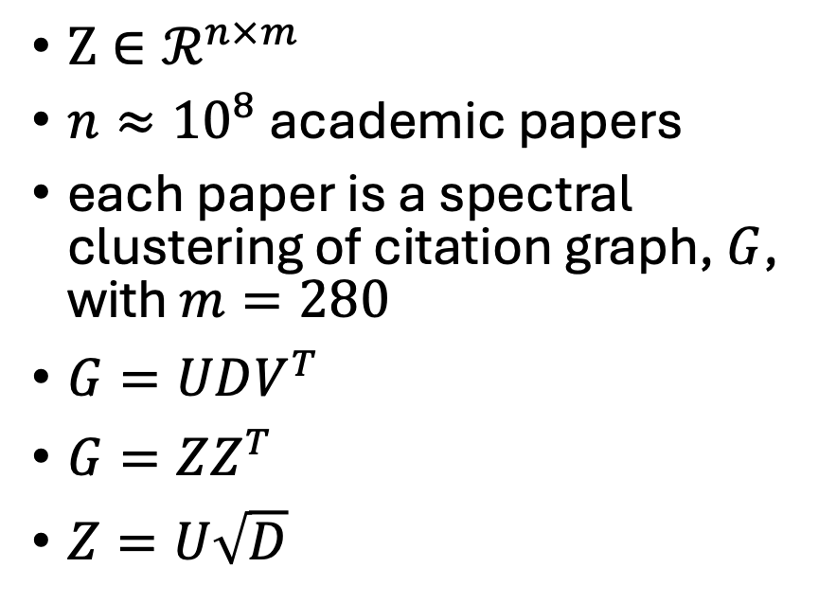
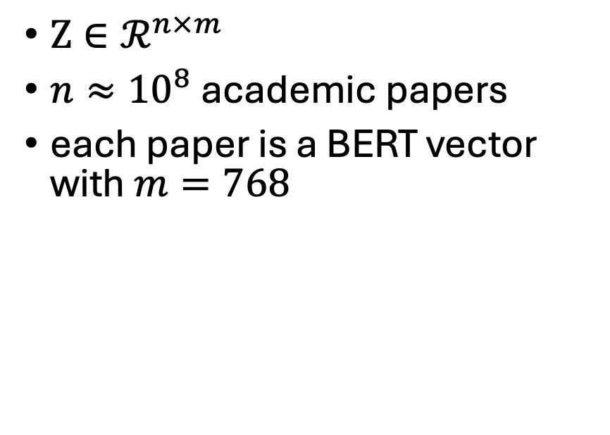
Better Together
BERT-like Embeddings of Papers
Graph Embeddings of Citations
$Z∈ℛ^{n×m}$
$n≈{10}^{8}$ academic papers
each paper is a BERT vector with $m=768$
$Z∈ℛ^{n×m}$
$n≈{10}^{8}$ academic papers
each paper is a spectral clustering of citation graph, $G$, with $m=280$
$G=UDV^{T}$
$G=ZZ^{T}$
$Z=U\sqrt{D}$
Generalize to capture random walks

Slide 19


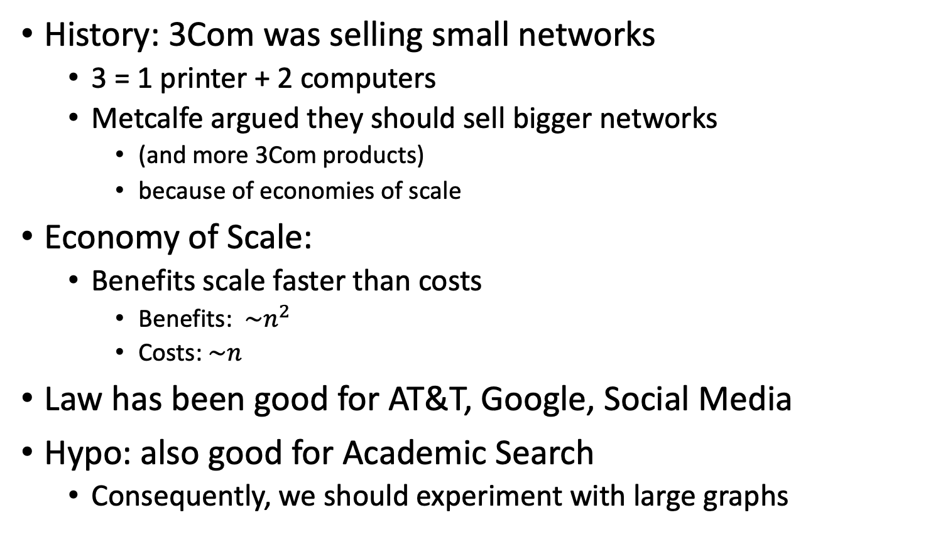
Metcalfe’s Law (Network Effects)
History: 3Com was selling small networks
3 = 1 printer + 2 computers
Metcalfe argued they should sell bigger networks
(and more 3Com products)
because of economies of scale
Economy of Scale:
Benefits scale faster than costs
Benefits: $\sim n^{2}$
Costs:$\sim n$
Law has been good for AT&T, Google, Social Media
Hypo: also good for Academic Search
Consequently, we should experiment with large graphs

Slide 20
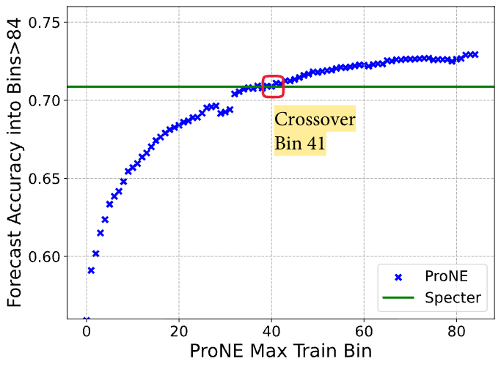
Network Effects
Larger Graphs → Spectral Clustering
Standard Benchmarks
Evaluate a single point
Miss the scaling effect

Slide 21
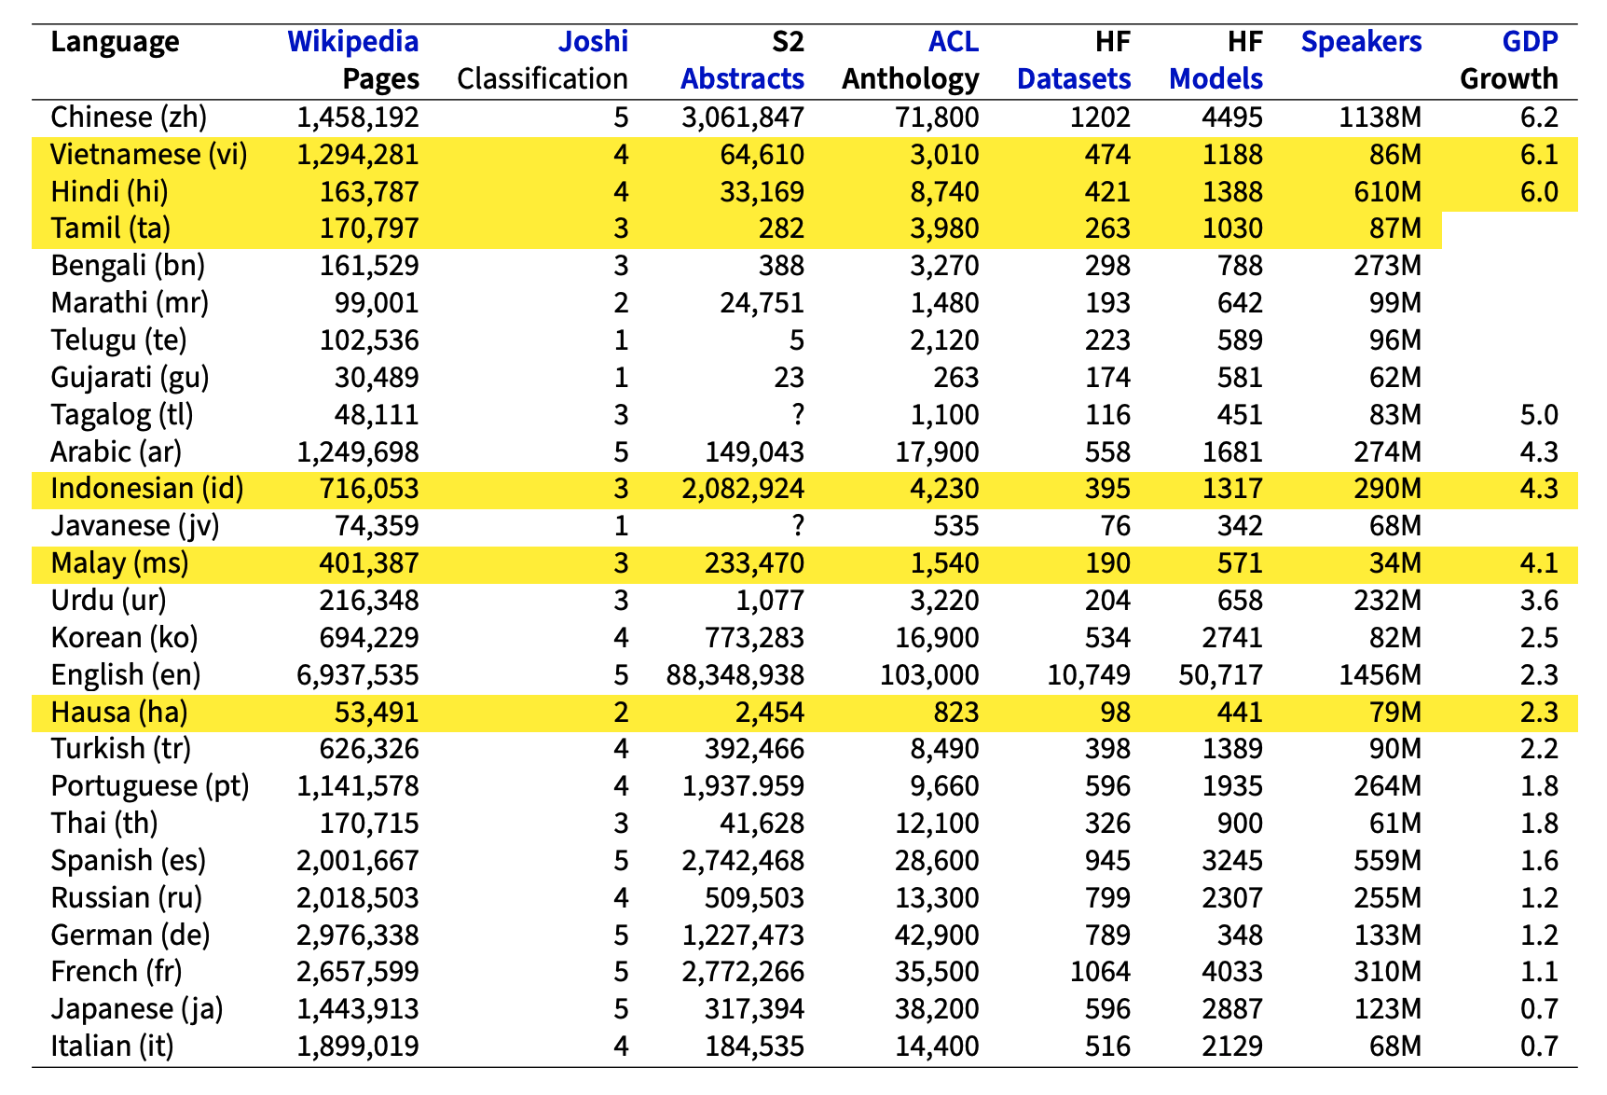
Low Resource Languages → Growth Opportunities

Slide 22
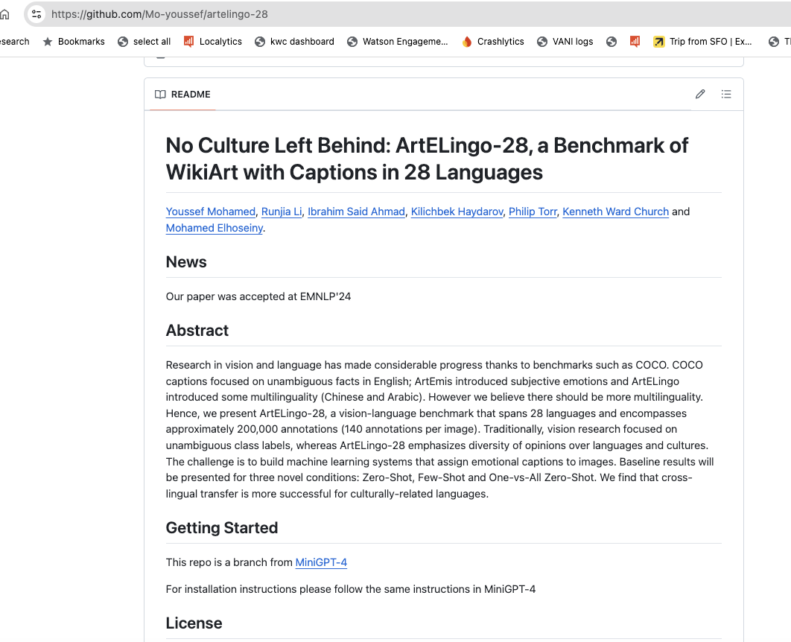


Slide 23
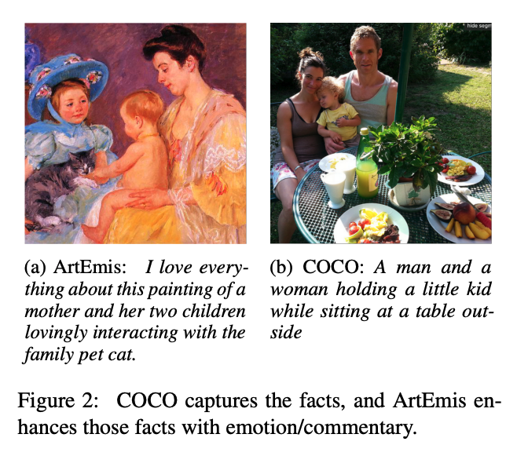
Adding Perspective to Speech/Vision Research COCO (Objective) → ArtEmis (Subjective)
Subjective Emotion
Objective
Facts
More room for Audience Background:
Culture/Language
Nouns: man, woman, kid, table
Modifiers: love, interacting, family
No Bounding Boxes

Slide 24
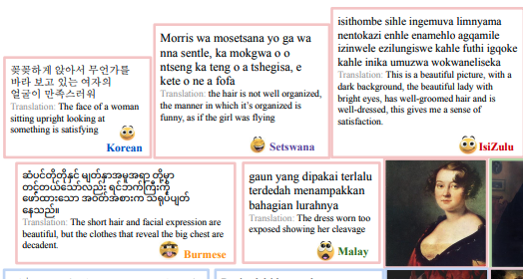
Embrace Diversity & Multiple Perspectives
emotion labels:
disgust (Burmese)
awe (Malay)
captions focus
on chest
Burmese & Malay
on face and hair
Korean & Setswana
Hypothesis:
Predictable
Ethics Review

Slide 25
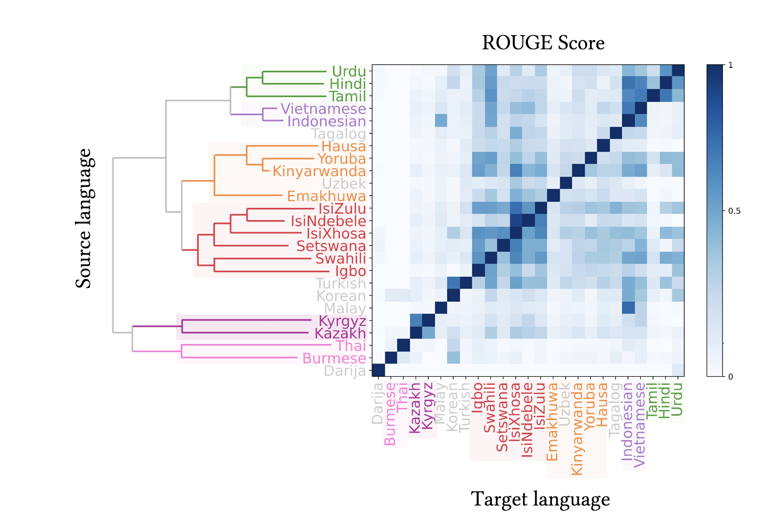

Slide 26
Agenda: Unifying Theme → Scaling
Macro (Large Market Forces)
Micro (Personal Research)
Moore’s Law: Everything is getting better
but at different rates
Peak Data:
Scaling laws assume unlimited data
Language data: limited by population bound
Who can afford to play?
Narrative: Big companies with deep pockets
DeepSeek showed anyone can contribute
Clouds → Phones
Inference >> Training
“Diseconomies of scale”
Implications for global warming
Unify LLMs and Linear Algebra
SVD with Batching
Better Together
Academic Search
BERT Embeddings of Papers
Spectral Clustering of Citations
Loss Functions
Entropy: Predict the next word
Nuclear Norm: within → across
Low Resource Languages →
Growth Opportunities
Target languages with future demand
Many speakers and impressive GDP growth

